Slide 1
Presentation for GamingEtc
George Fang

Slide 2
The Issue

Slide 3
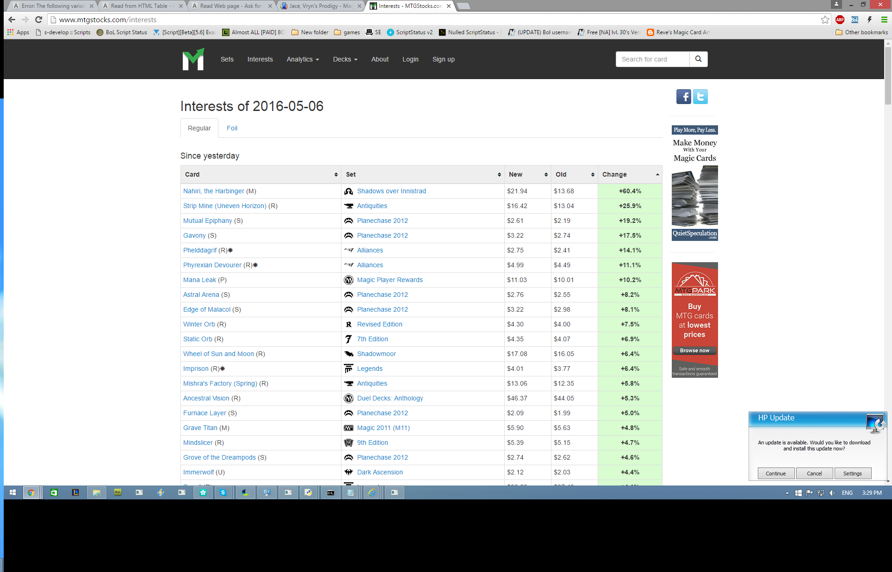
Current Process

Slide 4
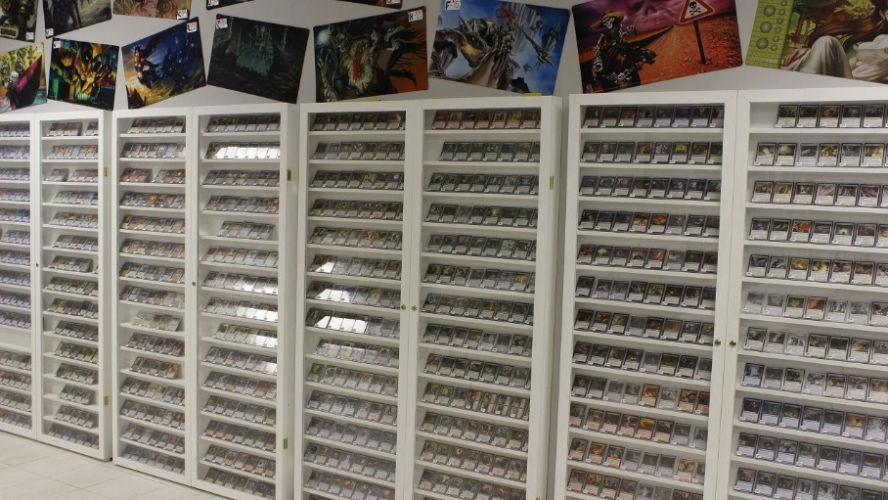
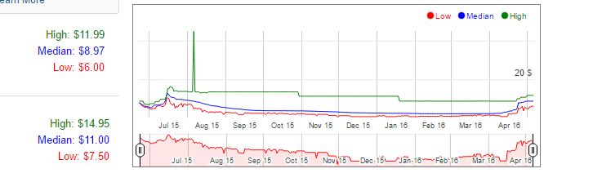
Problems with current solution

Slide 5





Proposed Solution
Automated Price Generation
Custom designed software for data retrieval
User-End emulation to bypass Distil anti-scraping protection
User Interaction
Script Injection
How does it work?
The custom designed software utilizes the COM (Component Object Model) design of Microsoft applications (Internet Explorer in this case) in order to inject scripts that interface with the application. These script injections allow the automated browsing of web pages in a manner indistinguishable from regular browsing. The program does not interface with TCGplayer.com, thus evading data scrape protection measures.
Script Injection

Slide 6
Benefits
Faster and more efficient than doing it by hand
Less human error increases accuracy
Ability to update all prices at once
Catch slow price changes over time
Wide variety of potential applications
Automated sale pricing
Automated buy pricing for “The project”

Slide 7
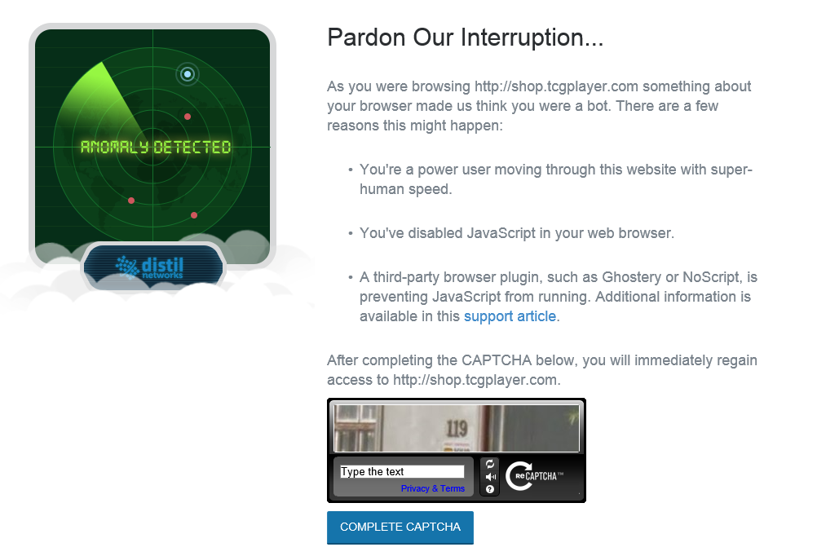
Risks
Distil captcha based security system
Speed (< .5 Seconds Per Page)
Quantity (>~250 Pages within ~20 minutes)

Slide 8
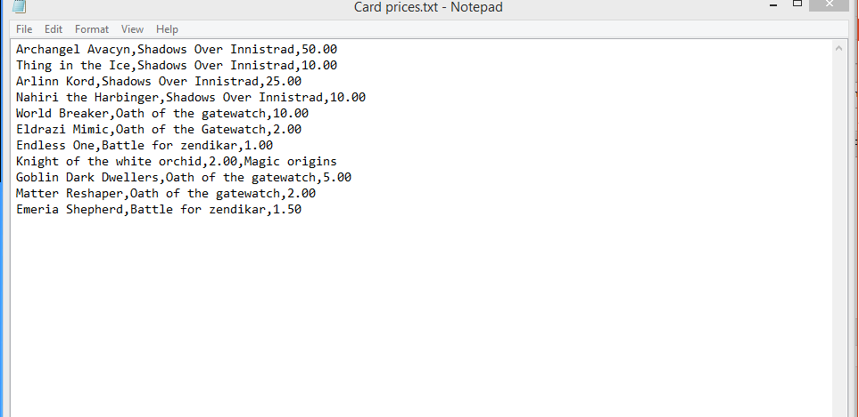
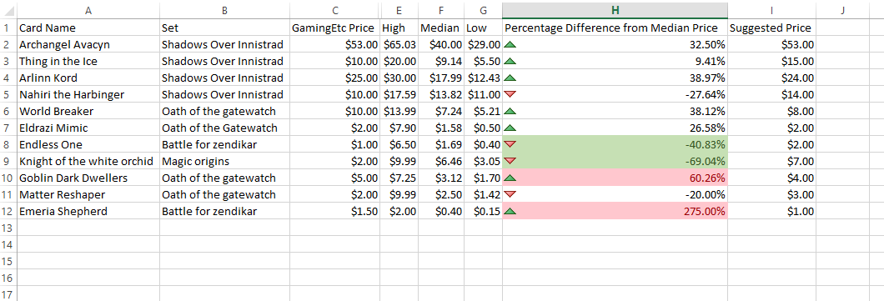
Implementation Suggestion
Report Based Implementation
PDF Form

Slide 9
Q&A
Thank you for listening!

